Slide 1
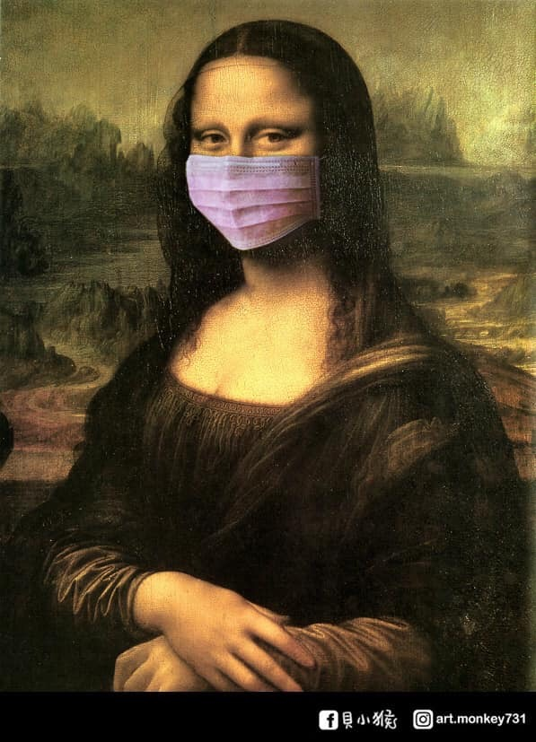
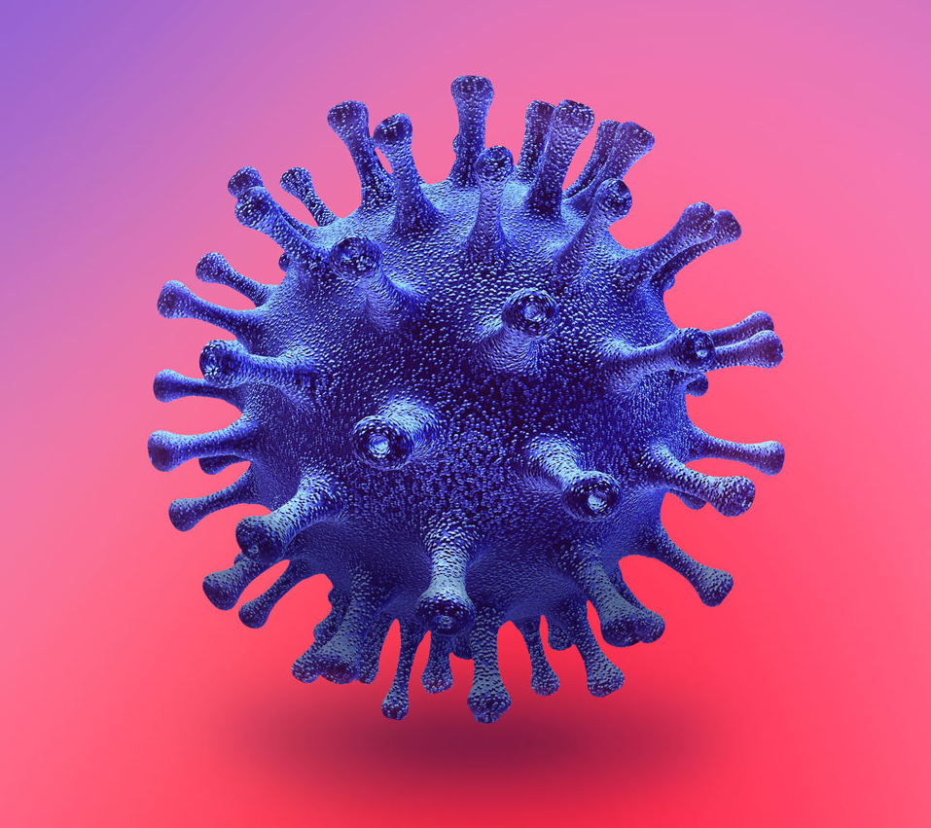
COVID-19 疫苗之發展與應用
謝思民
台大醫院感染科 主治醫師
台灣感染症醫學會 發言人
Notes:
Is HAART once-daily use possible?

Slide 2
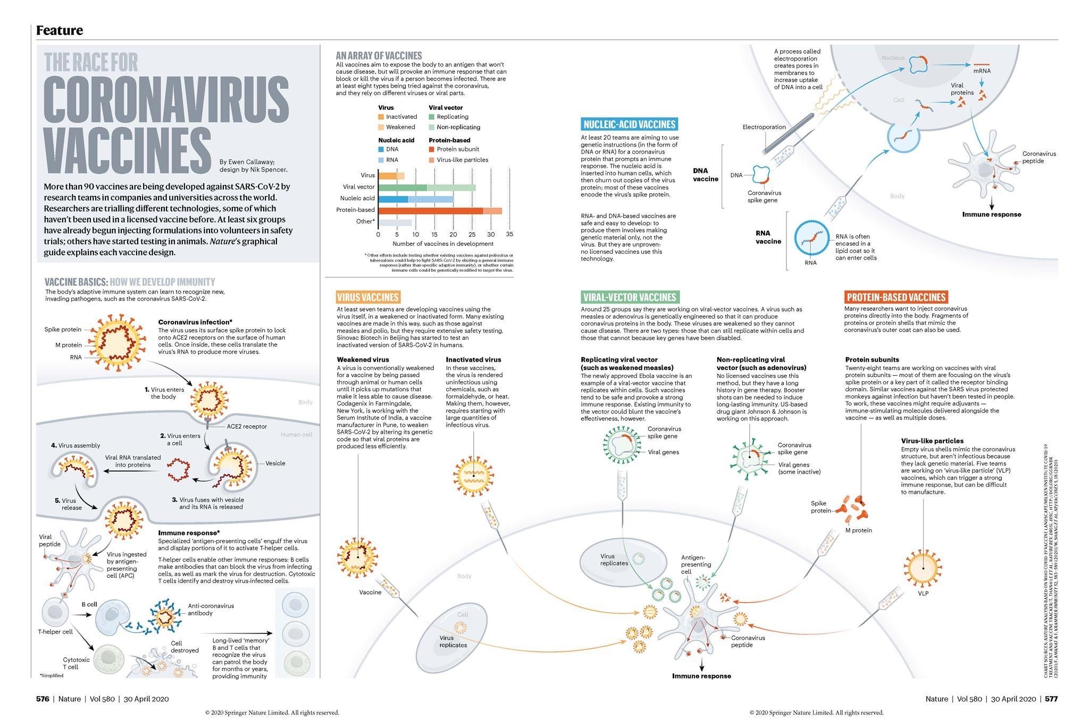
發展成功而能在臨床上使用者僅寥寥可數

Slide 3
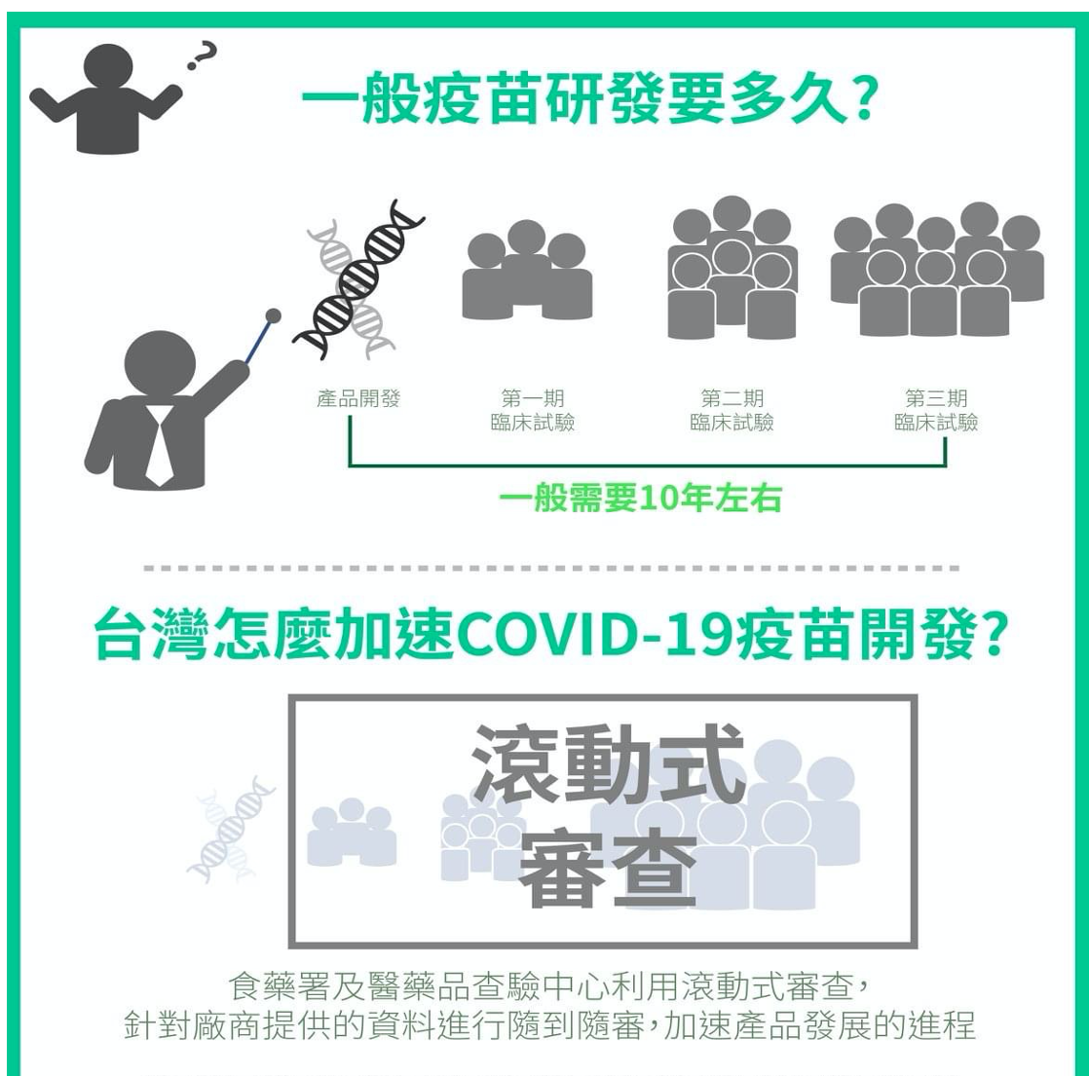
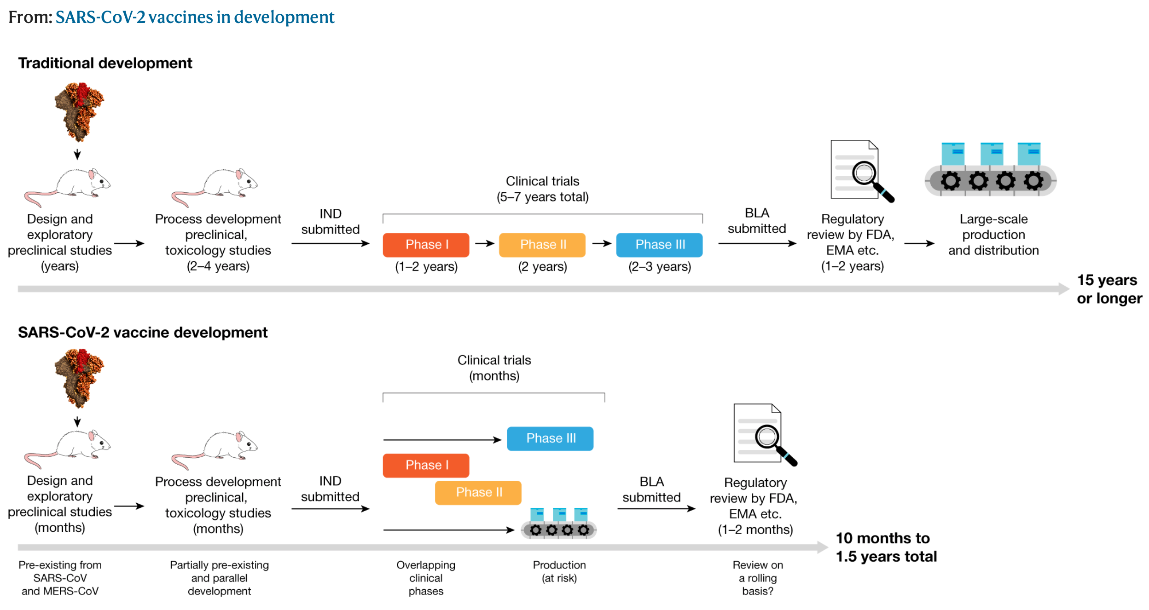
一邊打仗一邊研發製造武器
很多非典型非常規的例外！
中間必然有許多跳過或
省略的步驟：
各國面對疫情做出各自必要的妥協
及緊急授權

Slide 4
Protection from Vaccination 評估疫苗保護力的三項指標
Immunogenicity：免疫原性 (經標準化的中和抗體效價）
Efficacy：效力 (in placebo-controlled trial，僅限於當地還沒有其他疫苗被核准)
Effectiveness：效益 (在真實世界大量施打後的回溯性分析)

Slide 5
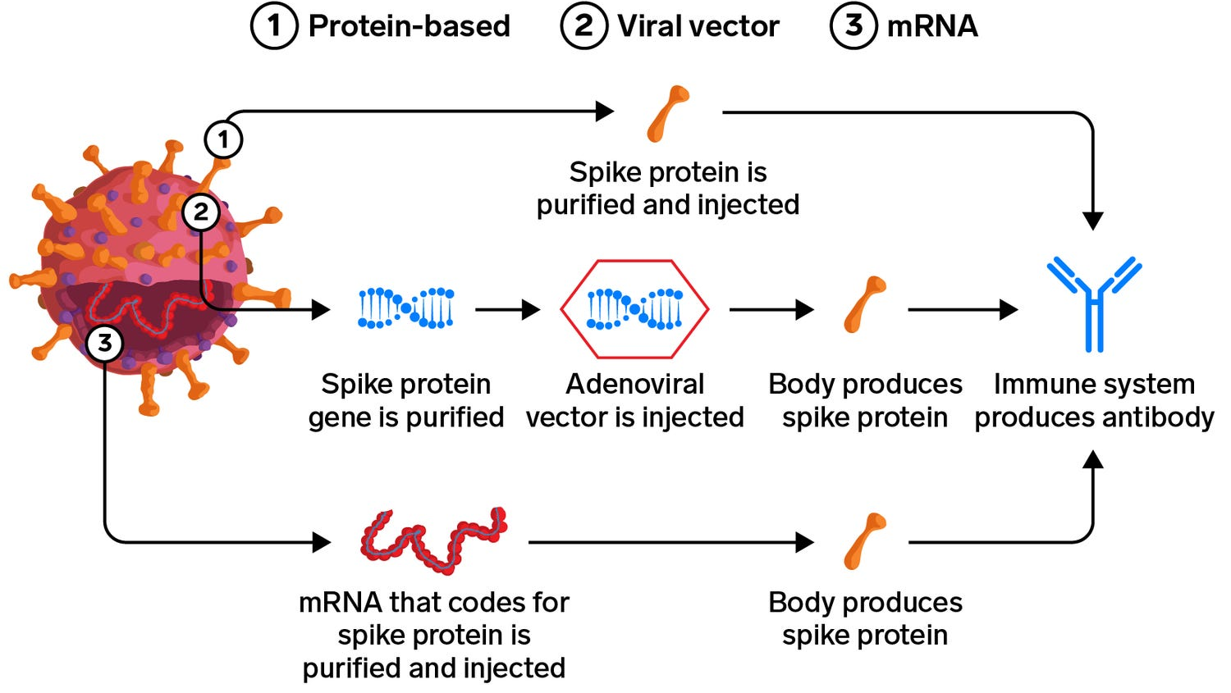
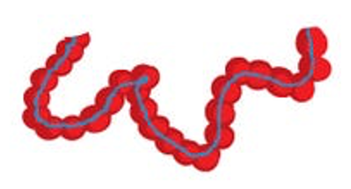
3 major types of vaccines
Acute kidney disease
Acute kidney disease
棘蛋白
and cellular immunity
混打策略能成功
的理論基礎之一
Lipid
nanoparticle
https://www.businessinsider.com/leading-us-coronavirus-vaccines-how-they-work-compare-2020-10
Notes:
這張圖是目前台灣可以打到的三種疫苗的作用機轉
最終目的都是要讓身體裡面有SARS-CoV-2 spike protein，讓身體產生anti spike protein的antibody

Slide 6
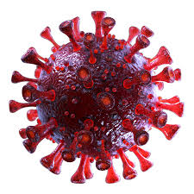
Full-length spike protein (S protein)
(Receptor-binding domain)
Nucleocapsid
Phosphoprotein:
Strong immunogenicity
(for ELISA, WB, LF)

Slide 7
Adenovirus-vectored vaccine (腺病毒載體疫苗) (AZ牛津疫苗; Janssen (嬌生J&J), CanSino解放軍疫苗)
DNA
即使已不再有關鍵角色 (退場中?)
但在疫情前期 曾是最能普及的疫苗

Slide 8
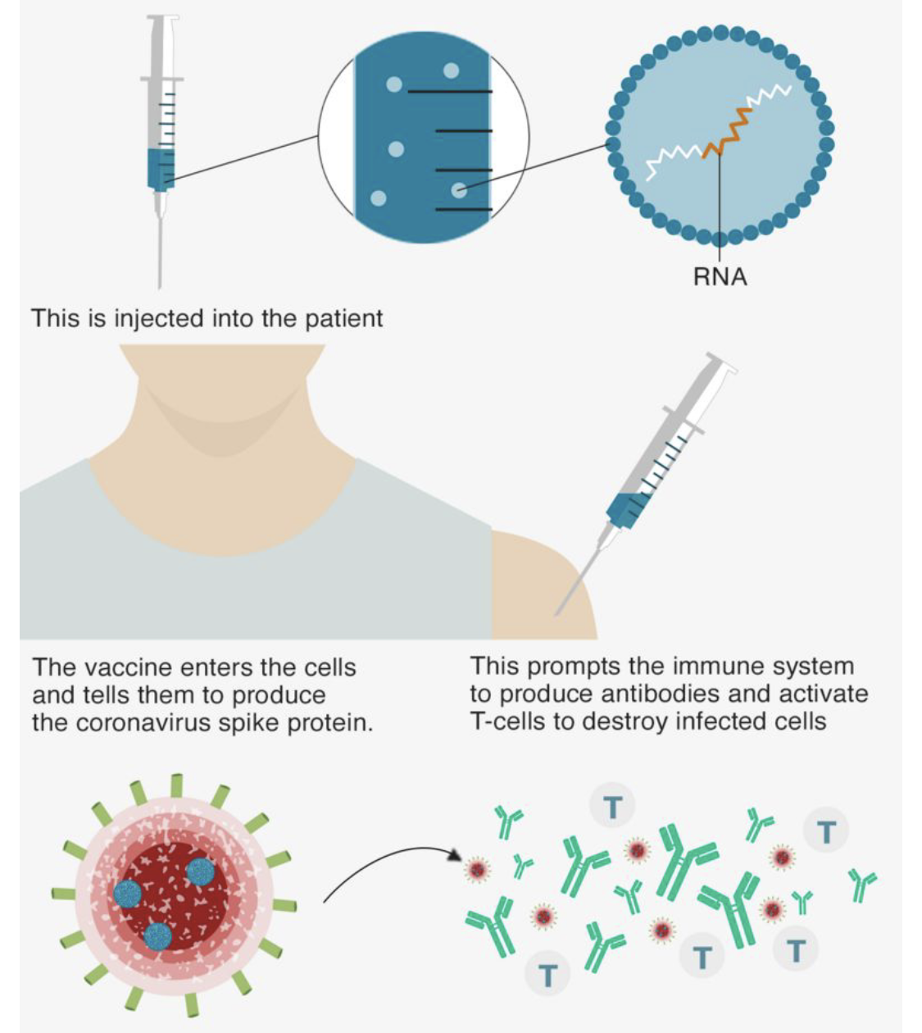
mRNA vaccine: 目前仍有關鍵角色
(輝瑞 Pfizer/BioNTech; 莫德納 Moderna/NIH)
A lipid nanoparticle–encapsulated, nucleoside-modified mRNA–based vaccine that encodes the SARS-CoV-2 spike glycoprotein stabilized in its prefusion conformation
1. 免疫生成性強
2. 能快速調整設計及大量生產
3. 不良反應較強
4. 在人類大量使用的觀察期不到2年

Slide 9
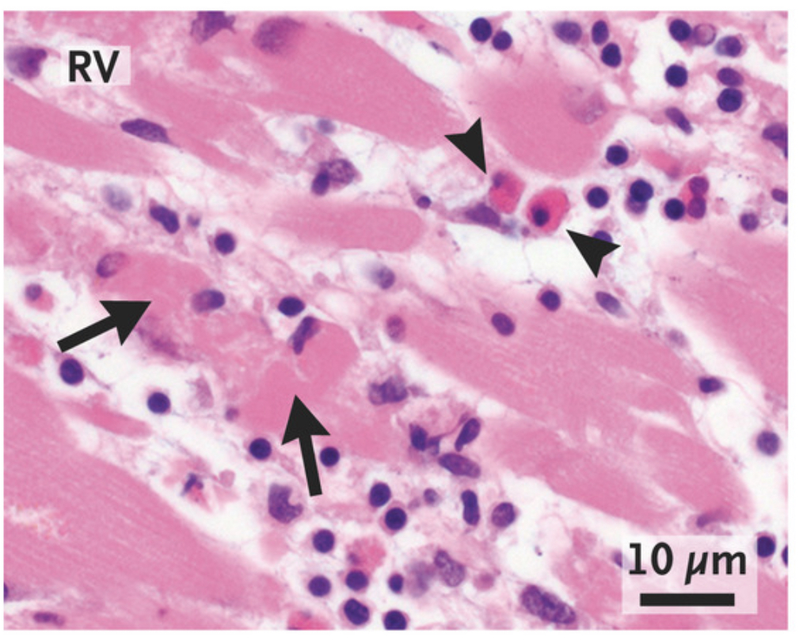
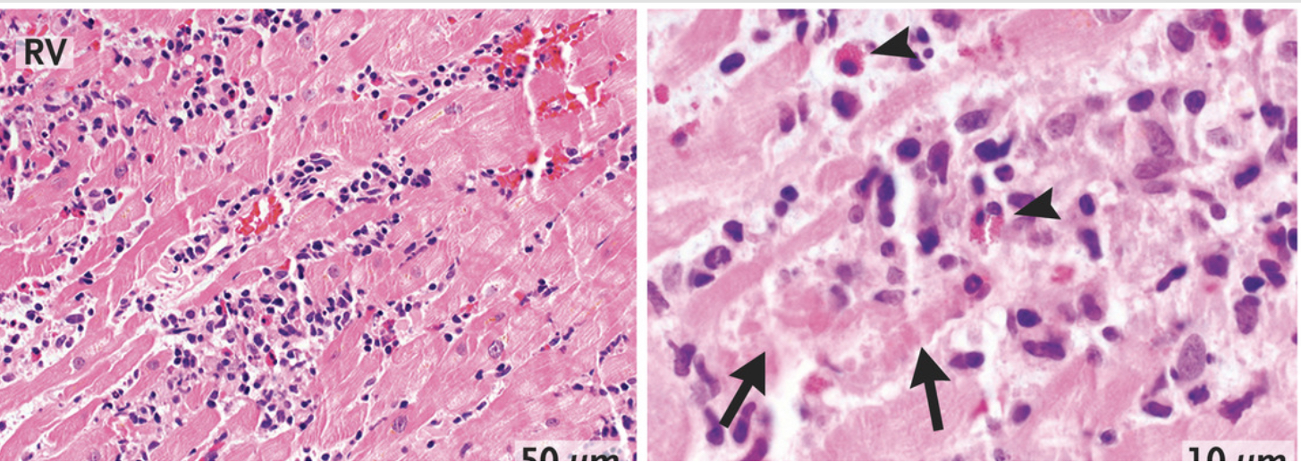

Slide 10
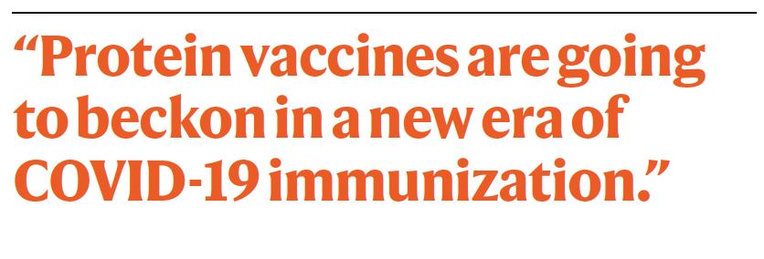
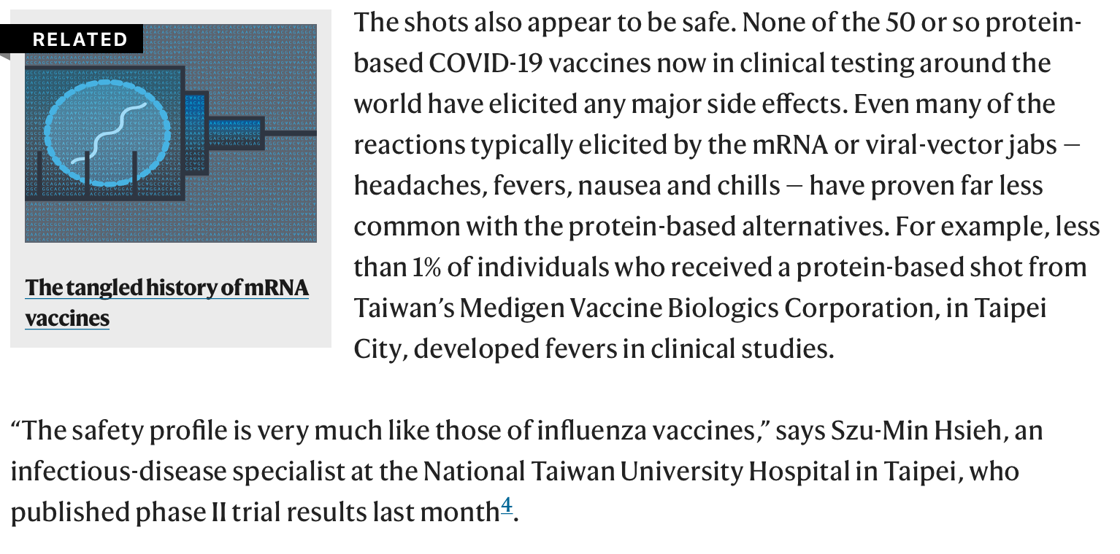
蛋白疫苗將如何改變新冠的全球流行？
1. 難以快速研發及大量製造
2. 安全性高，人類已有長期使用經驗
3. 運送方便，不需冷鏈系統
4. 減少世界各國的資源差距
5. 可能是長期需反覆施打的最佳選擇

Slide 11
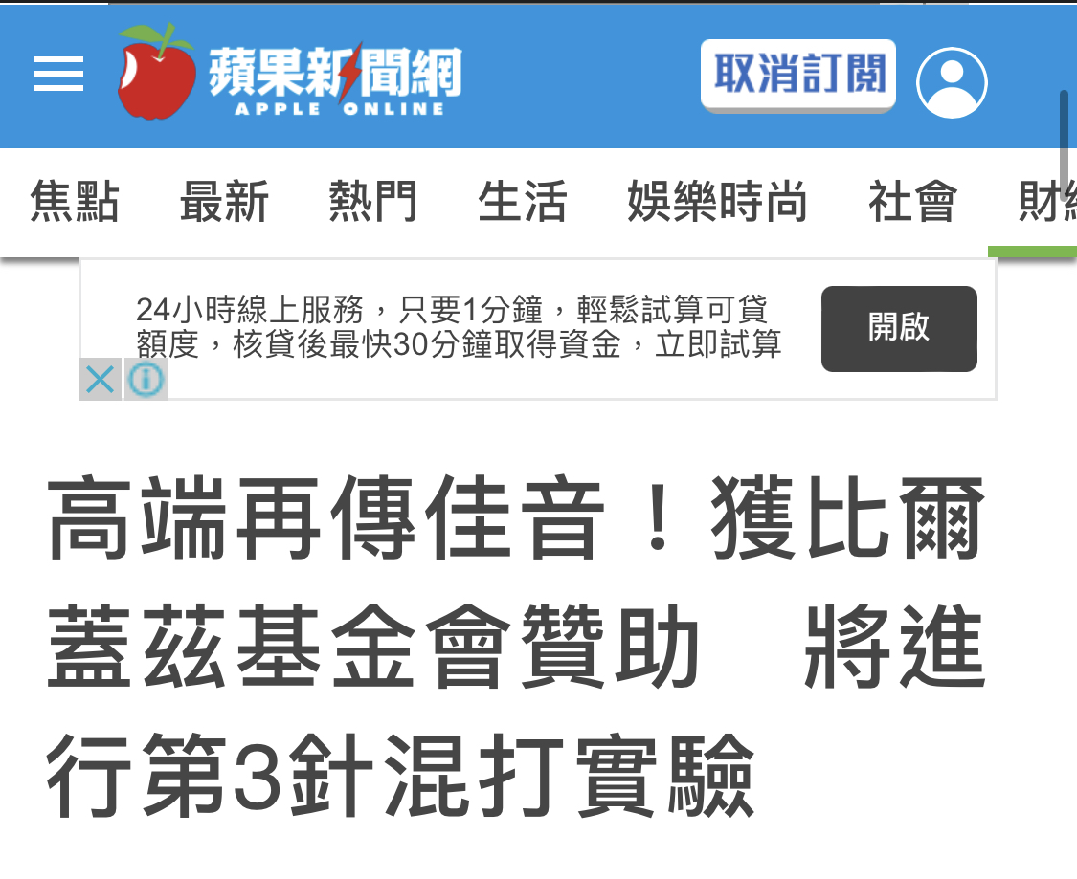
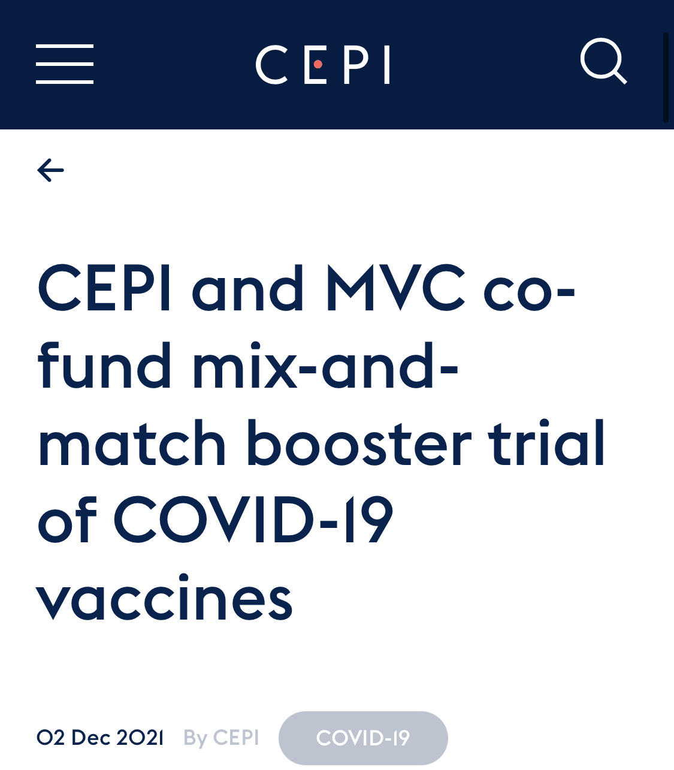
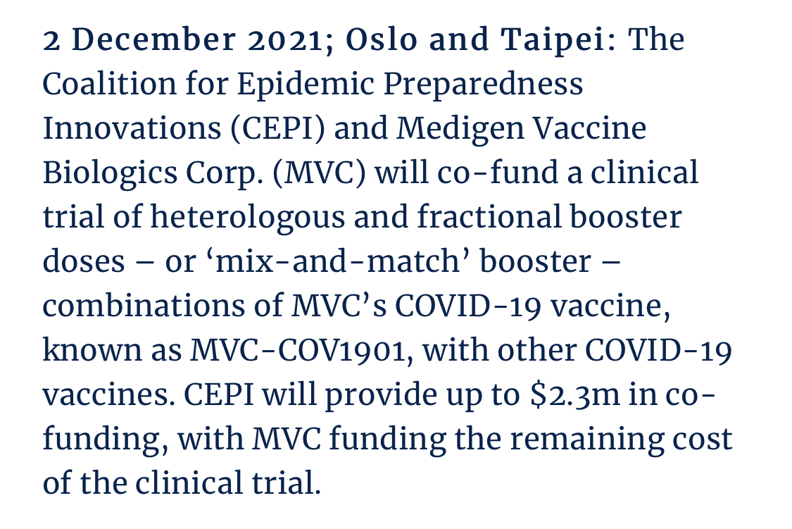
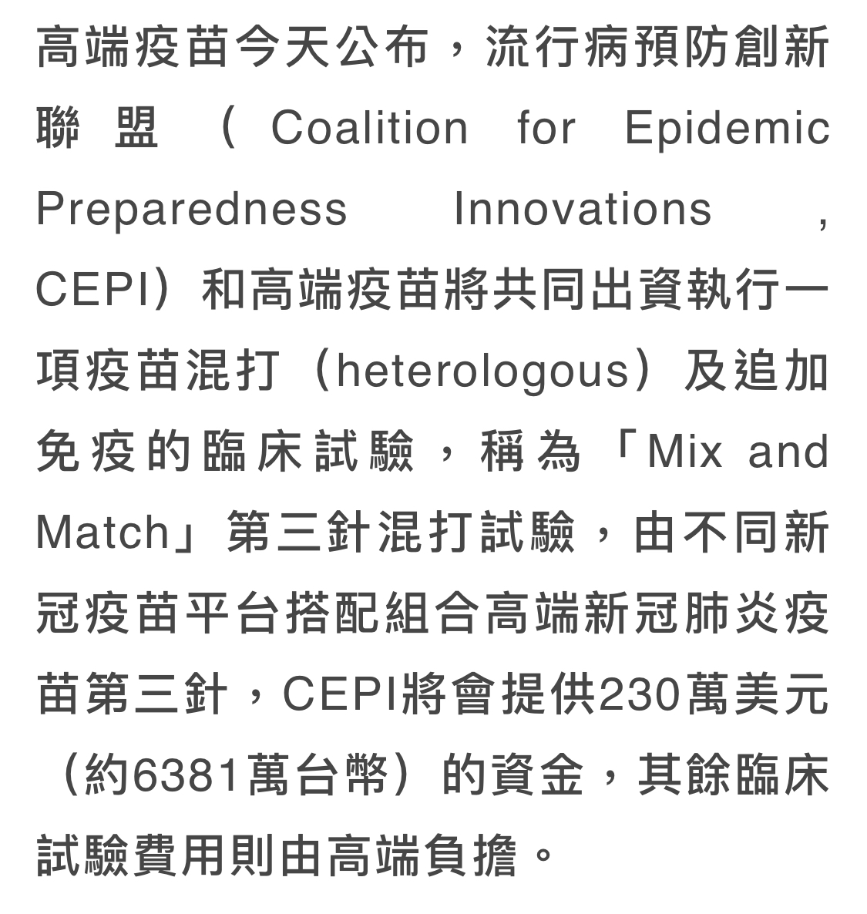
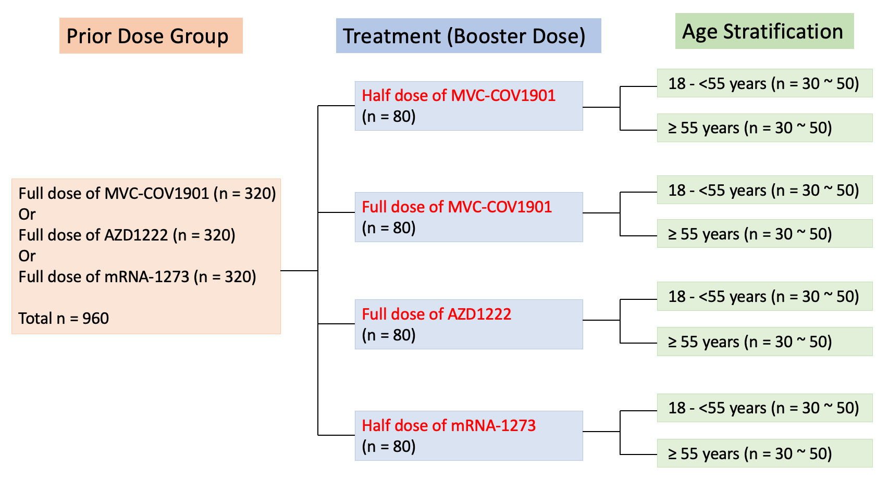
Coalition for Epidemic Preparedness Innovations
(流行病預防創新聯盟)

Slide 12
Funding UK Vaccine Task Force, Coalition for Epidemic Preparedness Innovations (CEPI), and National Institute for Health Research.
Novavax

Slide 13
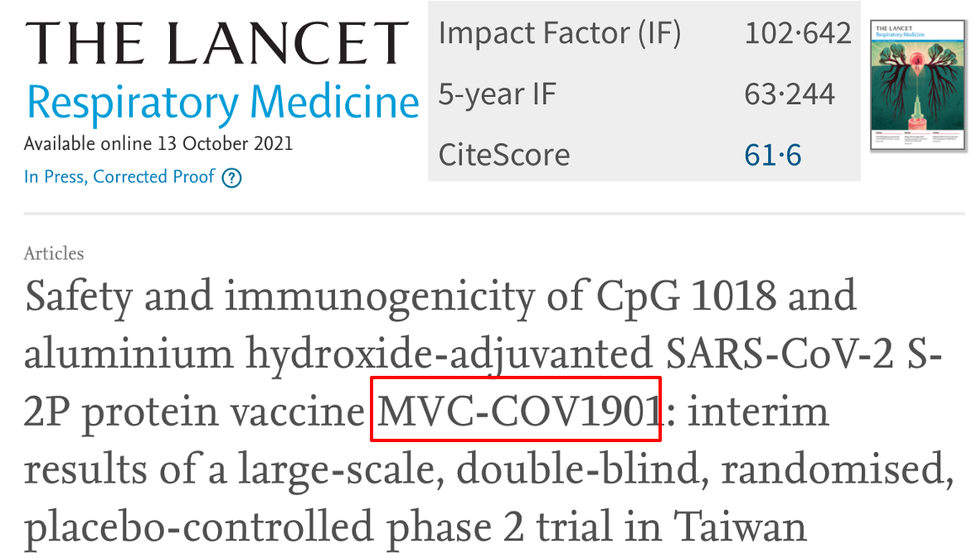
Phase III placebo-controlled
randomized clinical trial

Slide 14
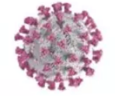
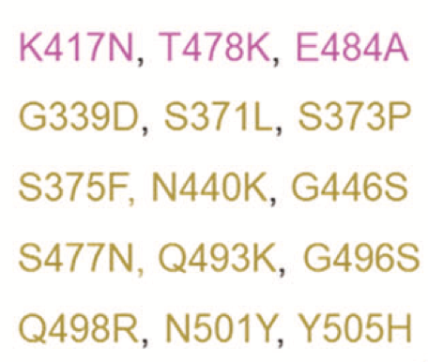
The Fourth dose？
The third dose？
Next generation vaccine？
Homologous and Heterologous？
(VOC: 需關注的病毒變異株)
Omicron
B.1.1.529
South Africa
32-37

Slide 15
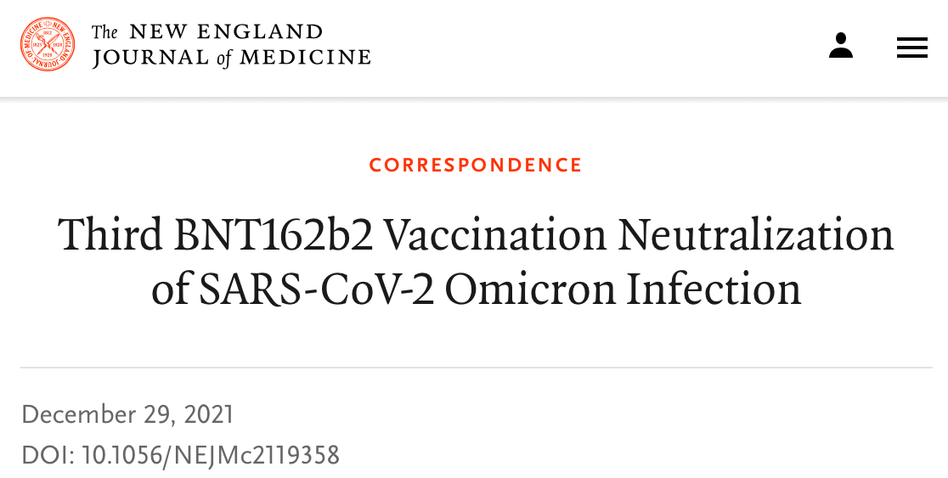
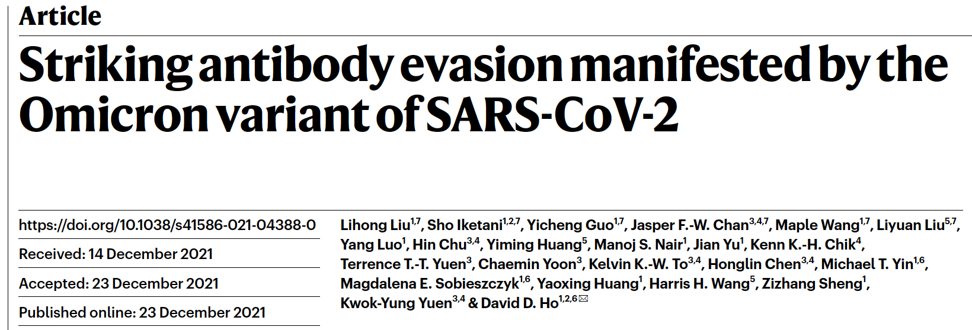
Antibody Evasion / Immune Escape: Omicron的“免疫脱逃”

Slide 16
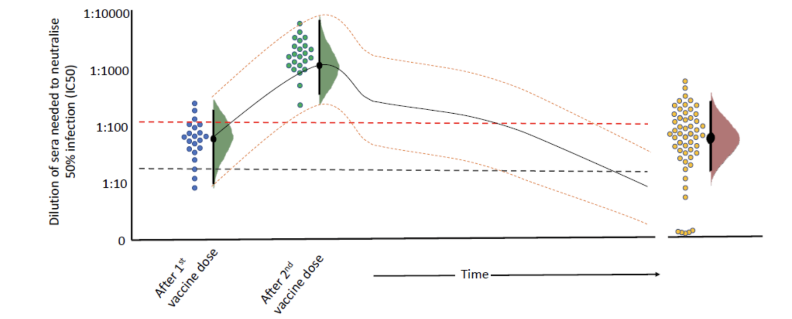
在兩劑的基礎劑之後，第三劑的重要性
Emergence of VOC
Decline in vaccine-induced antibody titers
Moderna: 5.2X
Pfizer/BNT: 17.7X
Novavax: 24.3X
Medigen: 6.3X

Slide 18
Significance of the third dose:
1. Reboost Ab titers
2. Better neutralizing capacity
against Omicron
3. Slower decline, better Ab
persistence
Hsieh SM, et al.
Infect Dis Ther 2022 (May 17)
Half-life: 44 days (95% CI 31-76 days)
Half-life: 12 days (95% CI 11-14 days)

Slide 19
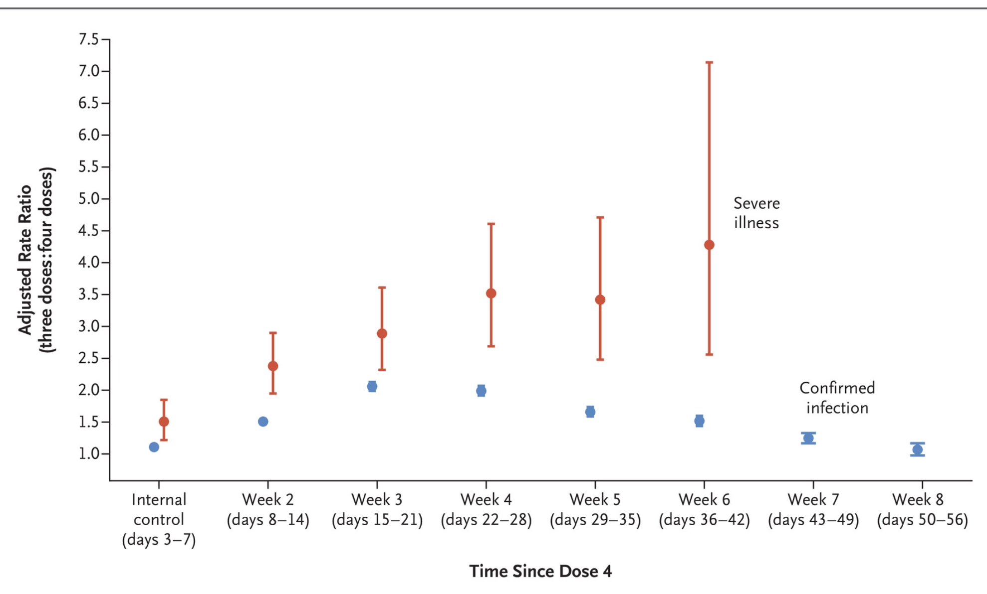
在Omicron的時代，施打第四劑
預防感染的效果很有限，
主要的幫助在減少重症及死亡
Rates of Omicron infection and severe Covid-19 were lower after a fourth dose of BNT162b2 vaccine in persons > 60 years old, than after only three doses.
Protection against confirmed infection appeared short-lived, whereas protection against severe illness did not wane during the study period.

Slide 20
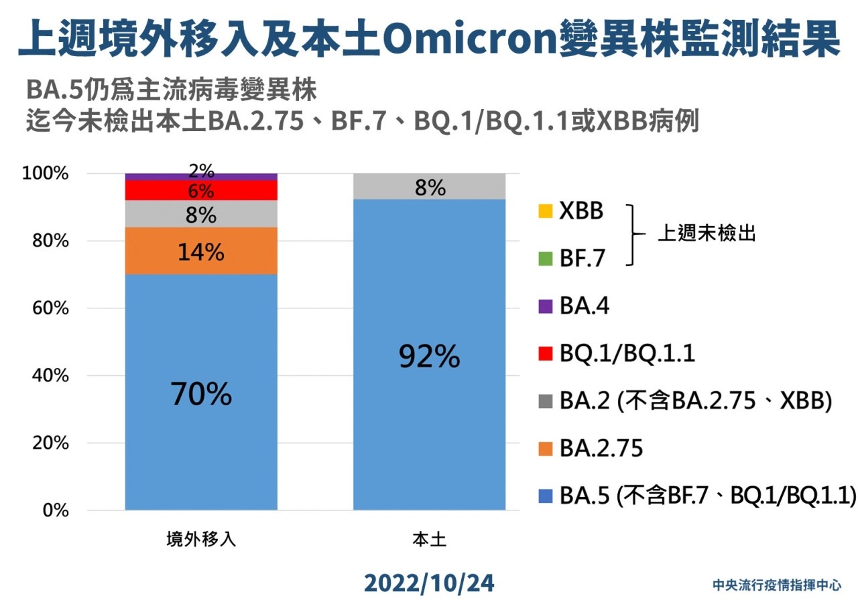

Slide 21
[原型株 + BA.5] 次世代疫苗 做為第4劑
真的能比 [原型株疫苗] 提供明顯更好的抗體效價嗎？

Slide 22
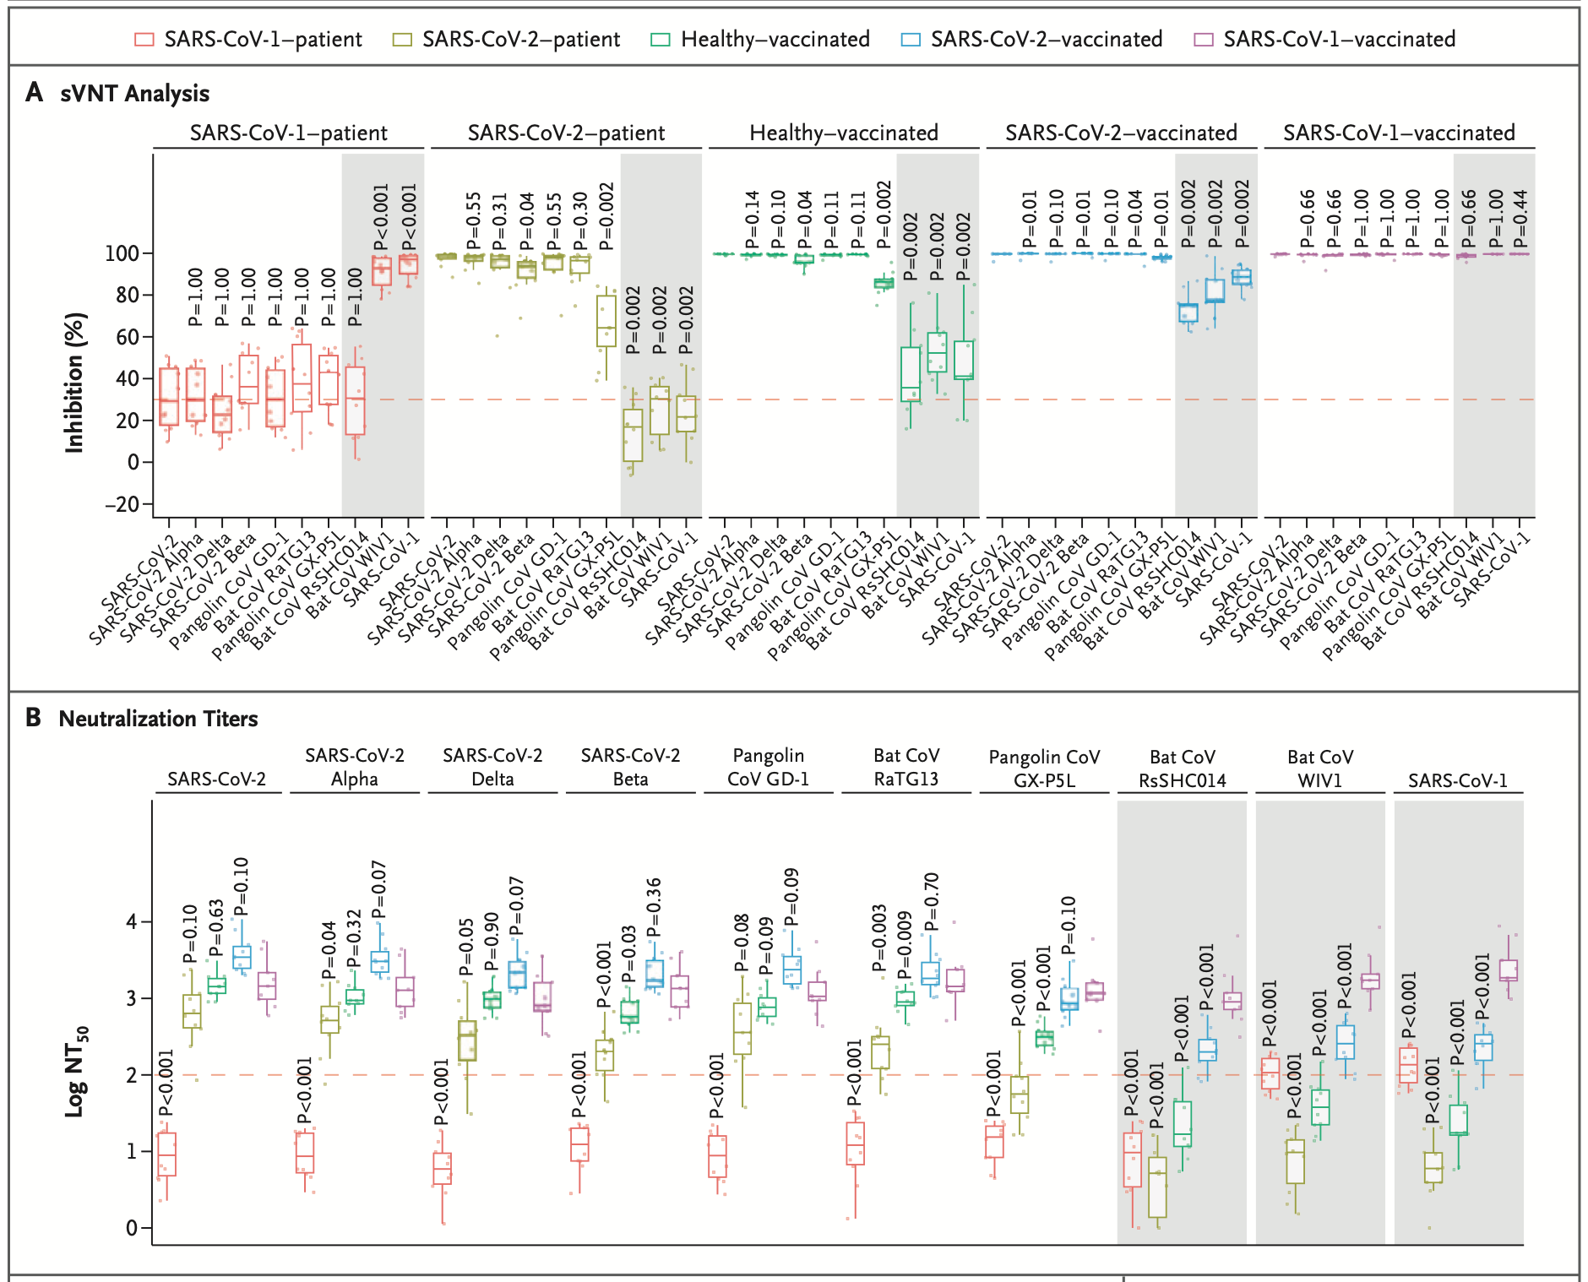
能產生對所有冠狀病毒 都能有效抑制的抗體 的通用型疫苗？

Slide 23
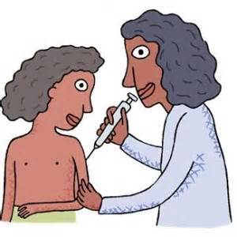
參與國產疫苗研發 主導 early phase vaccine trials 的設計/規畫/執行
Re-assessment for feasibility and dosage of smallpox vaccine 2003 (phase IV)
Pandemic (Pdm09) influenza vaccine 2009 (phase IV)
H5N1 vaccine (ProVEU) 2010 (phase I)
EV71 vaccine in adults 2011 (phase I)
Adjuvanted intranasal influenza vaccine 2012 (phase I)
New adjuvanted (HibmLT) meningococcal vaccine 2012 (Phase I)
MDCK-derived H5N1 mock-up vaccine 2014 (phase I)
MDCK-derived H7N9 mock-up vaccine 2015 (phase I + II)
New adjuvanted intranasal influenza vaccine 2017 (phase II)
Adjuvanted SARS-CoV-2 recombinant spike protein vaccine (phase I-II)
面對疫情，國家能有自己研發及產製疫苗的能力，非常重要！

Slide 24
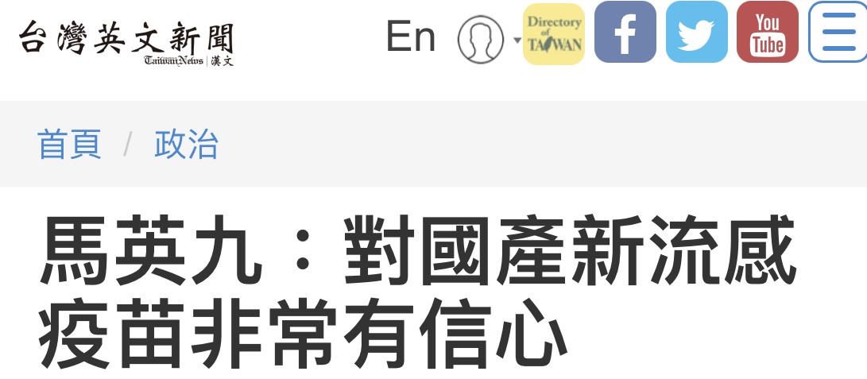
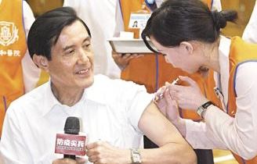
謝謝聆聽，大家多保重
2021
2009

Slide 25
Back-up slides

Slide 26
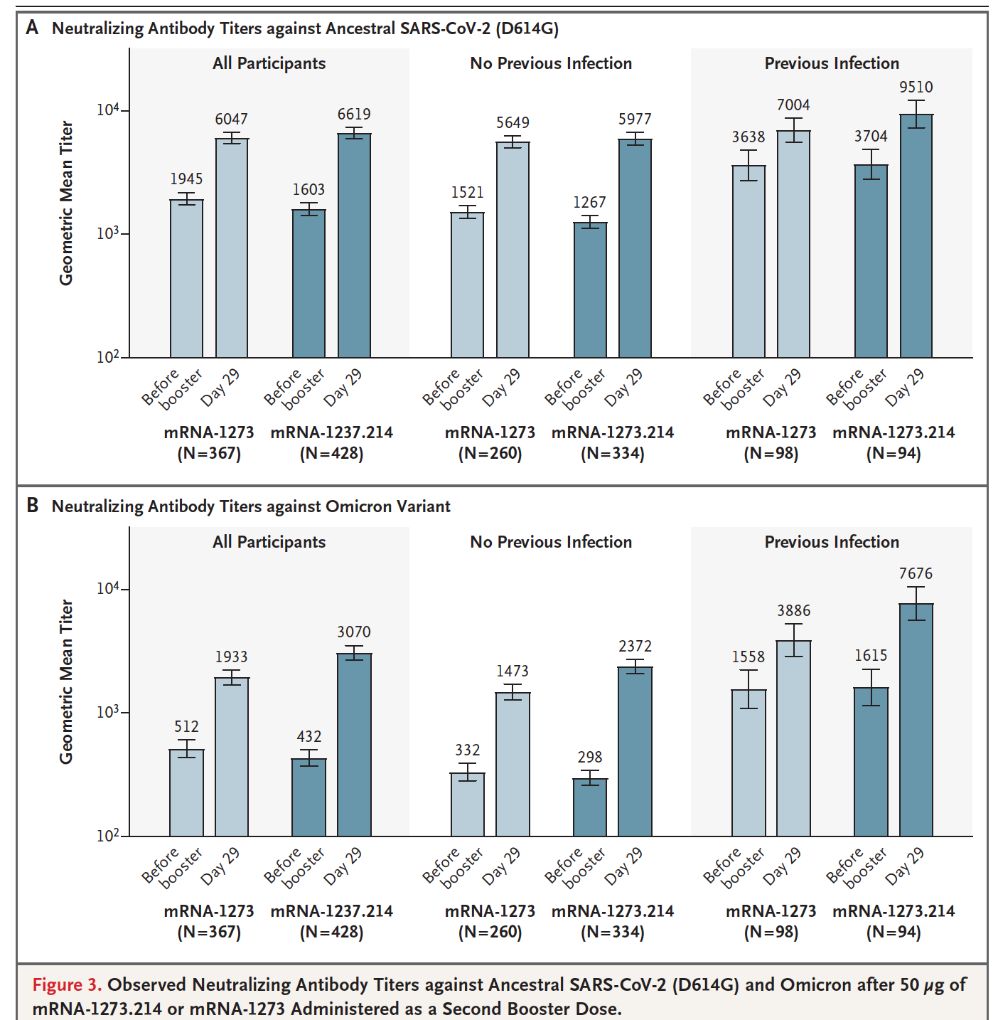
BA.4 / BA.5
2337
1271
727
492
609
719
140
116

Slide 27
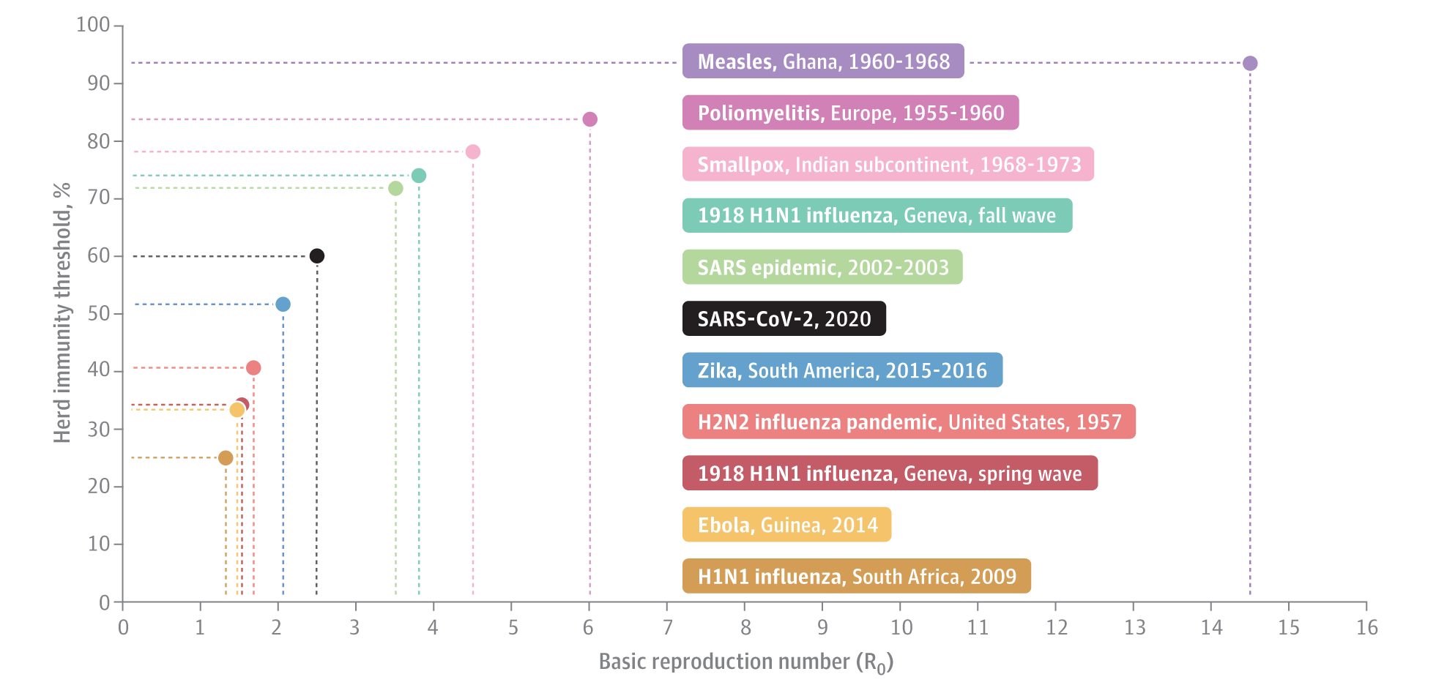
Published online October 19, 2020. doi:10.1001/jama.2020.20892
From: Herd Immunity and Implications for SARS-CoV-2 Control
台灣要藉由施打疫苗來達到對新冠病毒的群體免疫，
約需2360萬 x 0.65 x 2 ~ 3000萬劑疫苗

Slide 28
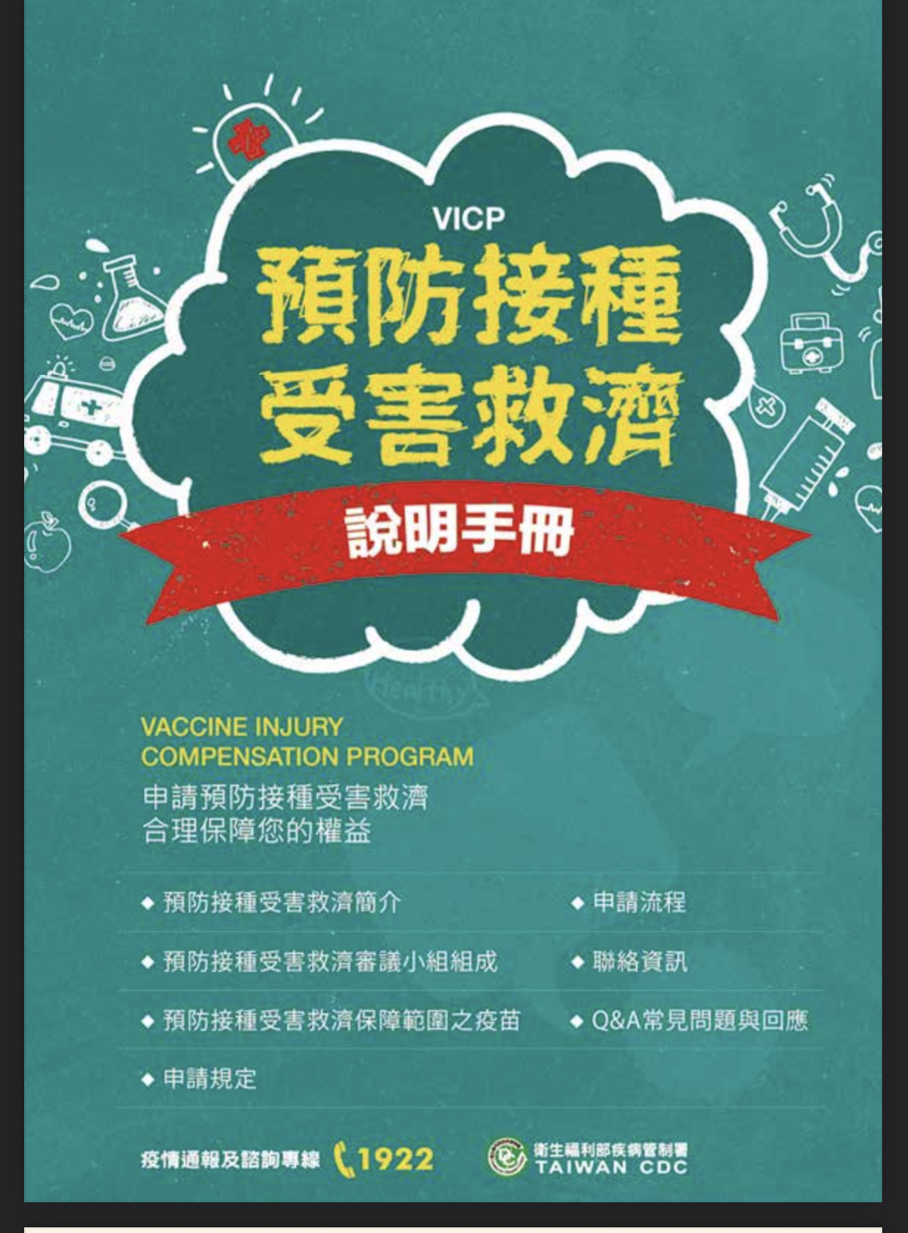
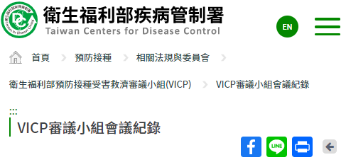
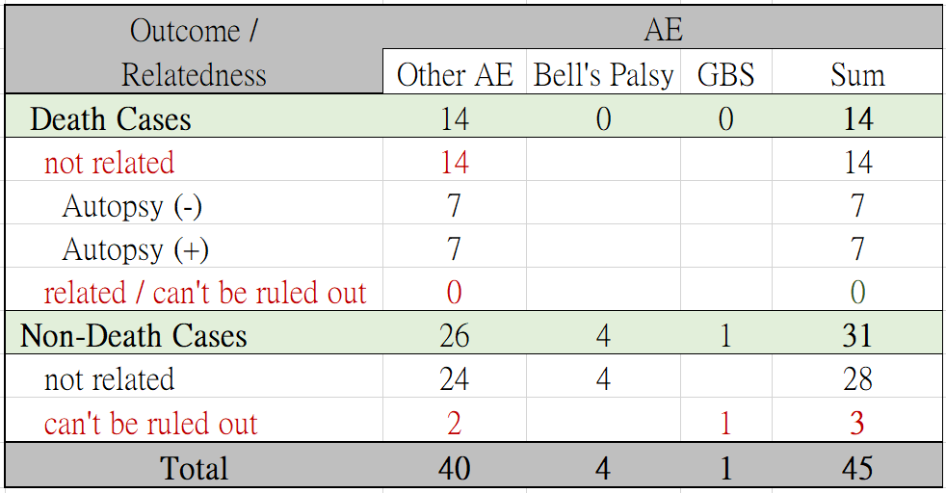
Review of VICP meeting reports
VICP審議小組會議紀錄
衛生福利部疾病管制署 (cdc.gov.tw)
(=皮膚癢, 紅疹)

Slide 34
16 Sep 2022

Slide 35
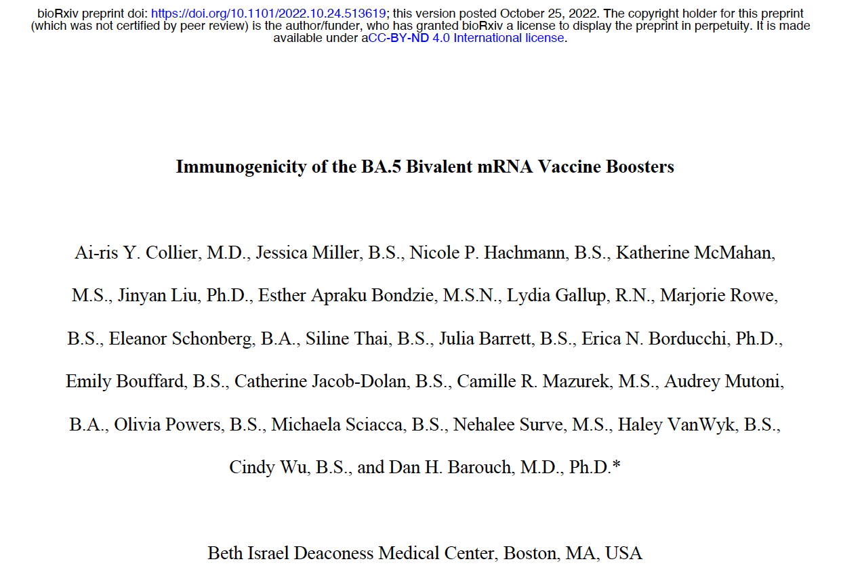

Slide 36
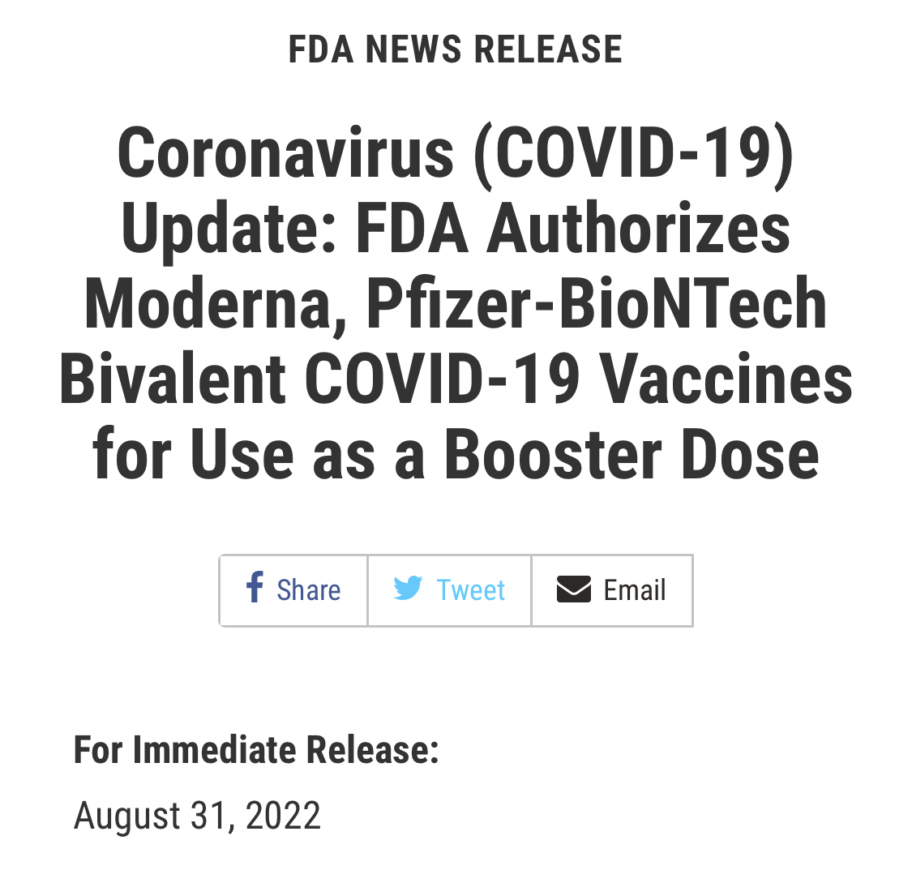

Slide 37
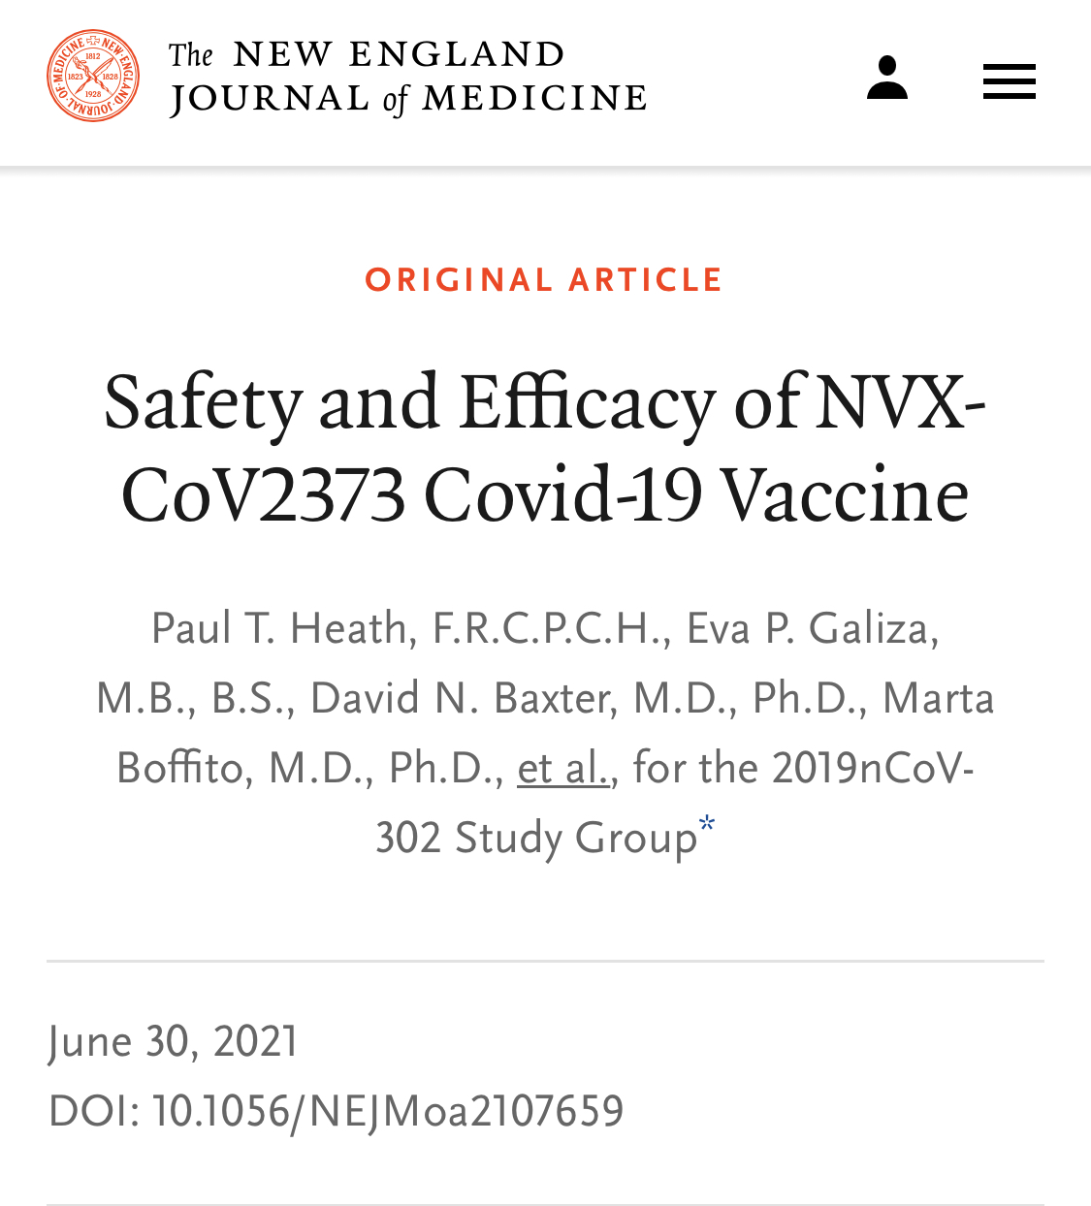
Protein-based vaccine (e.g. Novavax, Medigen, UBP)
Recombinant protein vaccines
Pros | Cons
No live virus needs to be handled Have been licensed and long-term experience Convenient transfer and storage Can use adjuvants to increase and polarize immunogenicity | need high yields antigen and/or epitope integrity needs to be confirmed

Slide 38
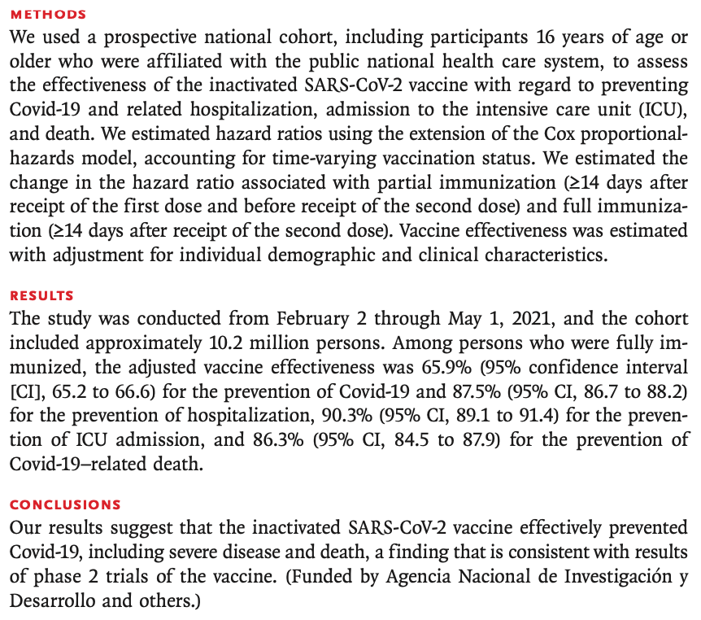
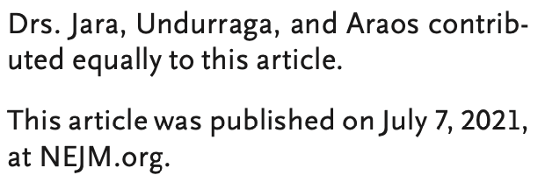
Inactivated virus vaccine
(去活化；滅活)
科興疫苗
(CoronaVac, from SinoVac)

Slide 39
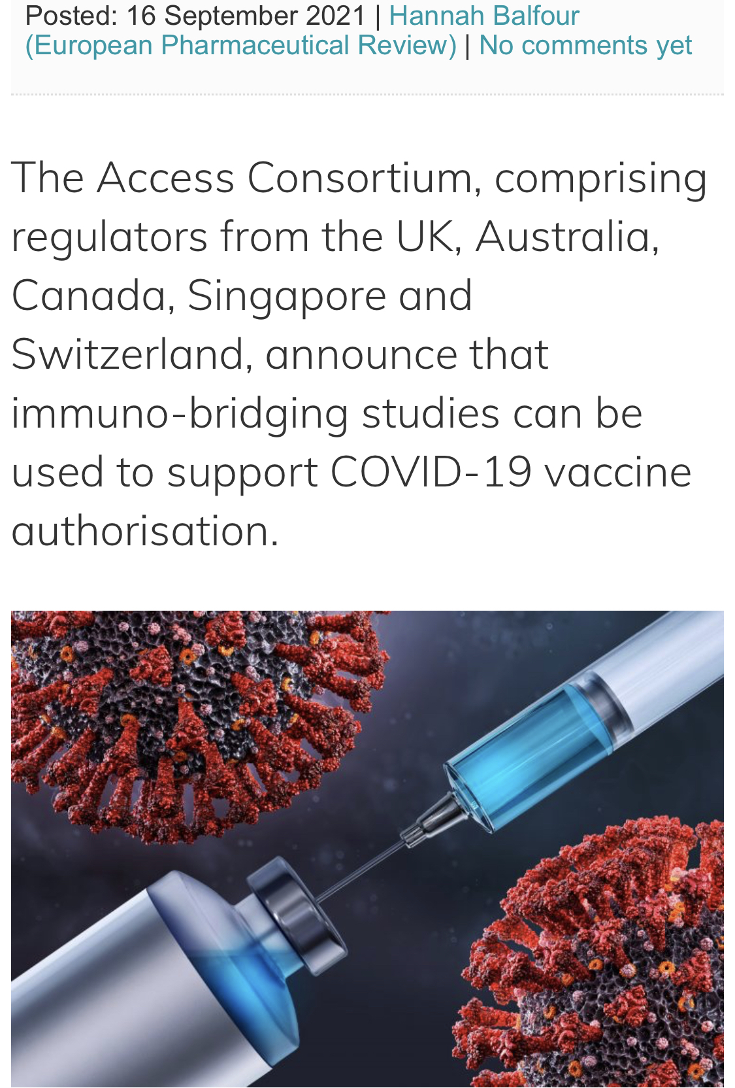
Consensus on Immunobridging

Slide 41
What’s The Next of The MVC-COV1901?
Phase 3 immunobridging trial
The 3-dose schedule
Heterologous prime-boost vaccination

